Slide 1
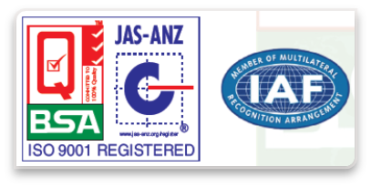
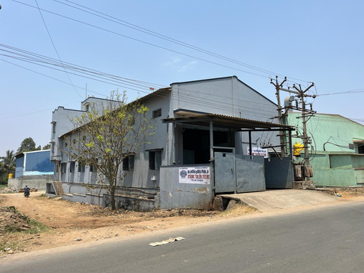
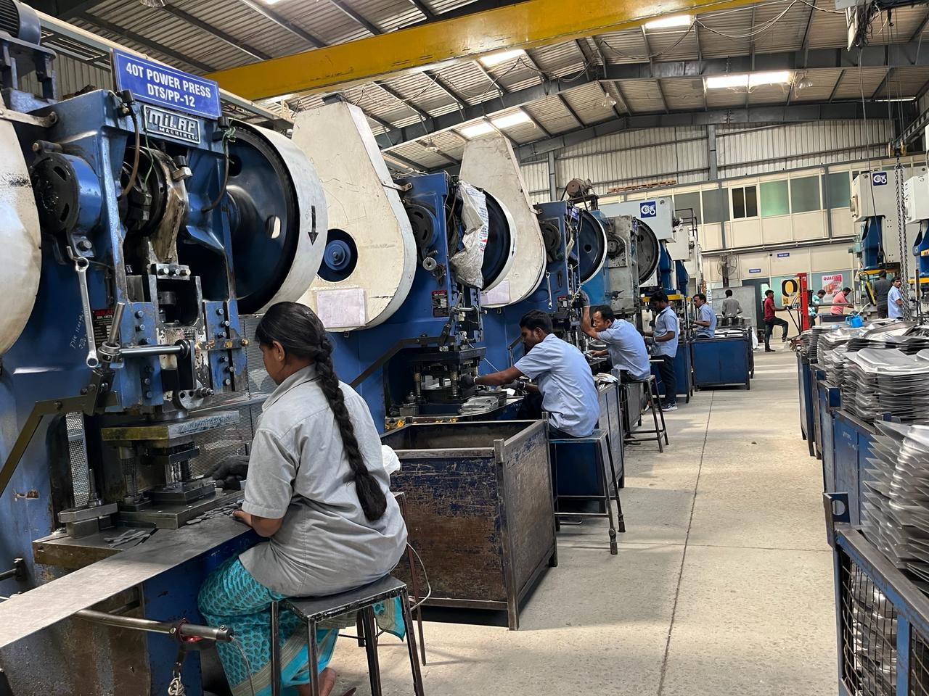
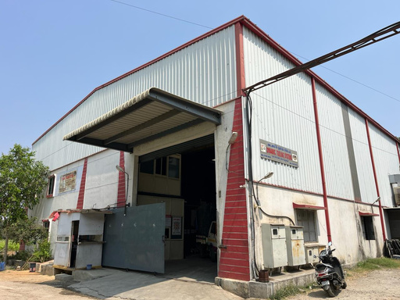

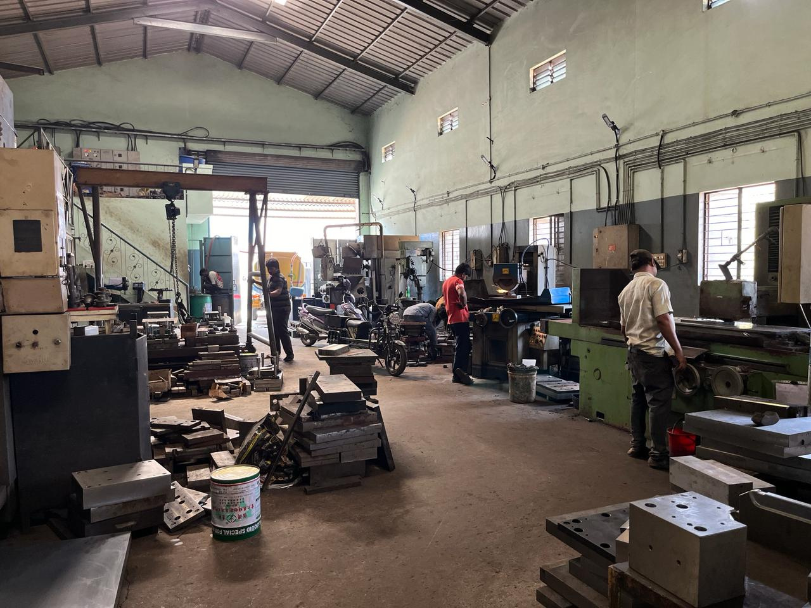
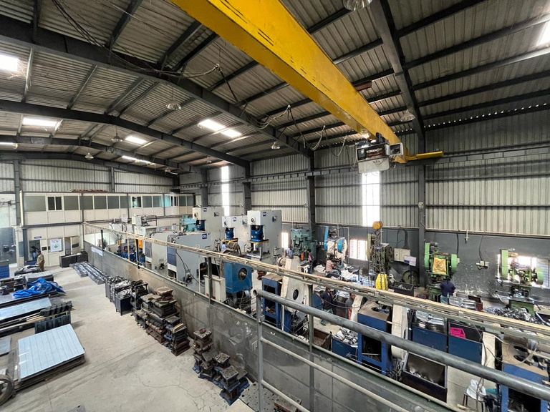
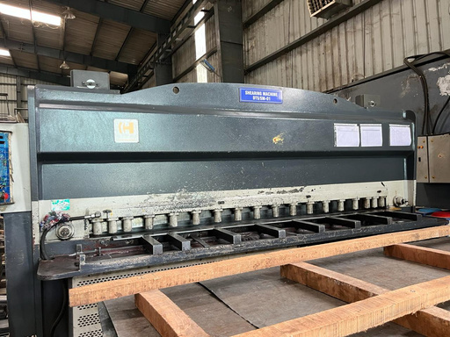


S.No:14/2, Plot No.2-4, DTS Complex, Anumepalli, Near Rajeswari Layout, Zuzuvadi, Hosur – 635 126. Krishnagiri Dist., TamilNadu.
Mobile : 9750939432/33

Slide 2

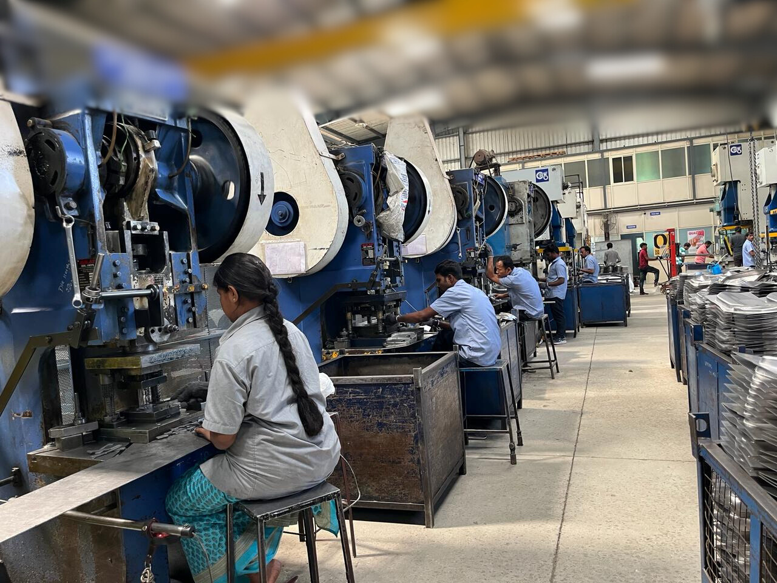

About Company
Dynamic Tooling Systems was established in 2004.It is an automotive company which specializes in supplying of Press Tools, Press products, Sub-Assembly Components, Jigs, Fixtures, Gauges & CNC Milling Works for Automobile Applications.
With over 19 years of experience in the Automotive Industry, we continue to provide Precision and High Quality work. Established in 2004 as a small - scale industry manufacturing sheet metal components, the company has grown up in size and operation into a well-respected medium scale industry with a reputation for consistently high quality and timely deliveries.

Slide 3
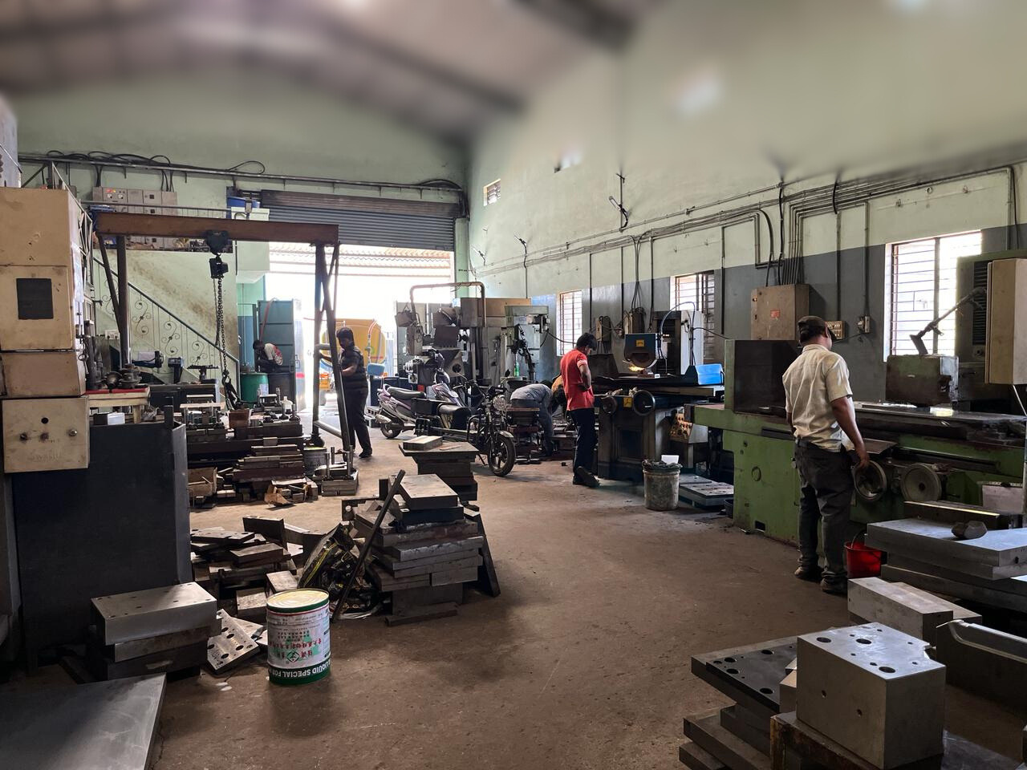
About Company
To meet the current volume and quality standards, we are already equipped with a wide range of equipment and systems in a completely integrated manufacturing plant at Hosur.
We have a team of well qualified Engineers in designing, machining and inspection. Our factory is an ISO 9001:2015 Certified Company.

Slide 4
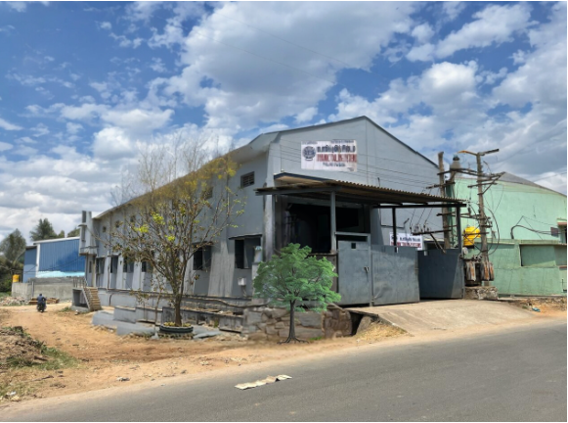
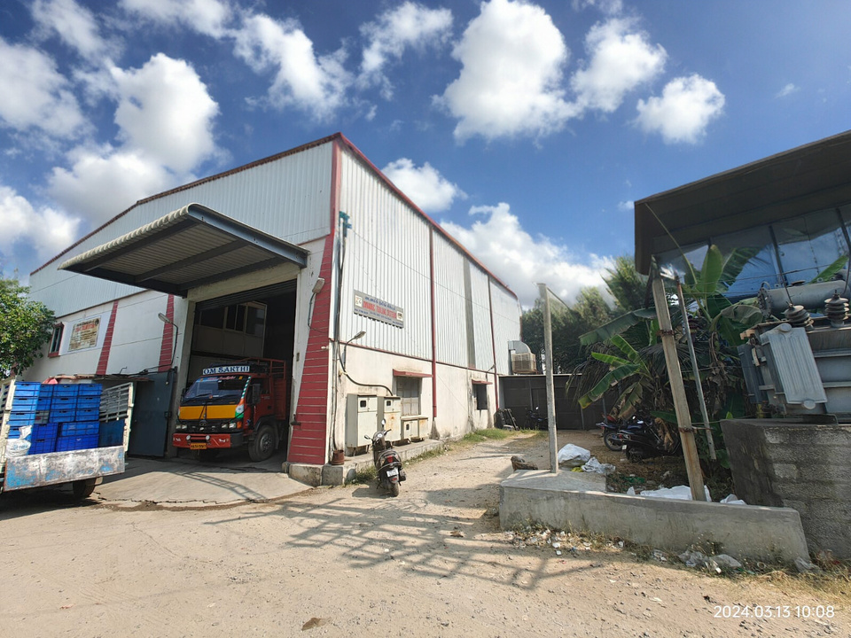
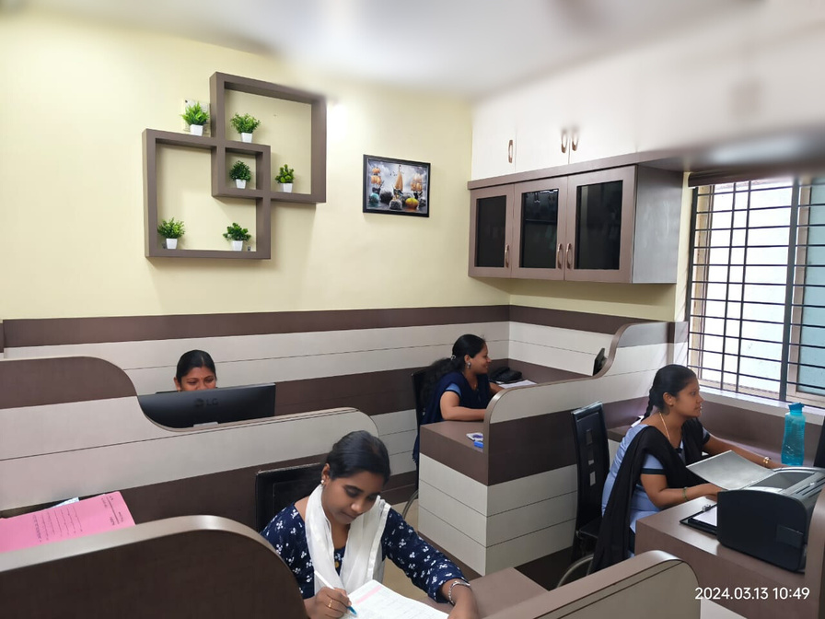
UNIT – I (TOOL ROOM)
UNIT – II (PRESS SHOP)
OFFICE

Slide 5



OUR SERVICES
PRODUCT
QUALITY
The development of company has more enthusiastic senior experts in the industry, with a team of experienced, comprehensive, dedicated engineers and technicians. So that the company has a strong technical development capacity, according to customer requirements, design of high quality and high precision products.
In both design and manufacture, Dynamic Tooling Systems ranks among advanced ranks of automobile accessories development. Providing a series of services such as design, sample processing and development for customers in India, it has become a supplier of many automobile manufacturers in India.

Slide 6


OUR
MISSON
Looking forward to the future, the company in line with the “people oriented”, “sincere faith”, “quality win” spirit of enterprise, to become the global automotive refitting industry leader goal, to provide customers with quality products and services unremitting efforts.

Slide 7
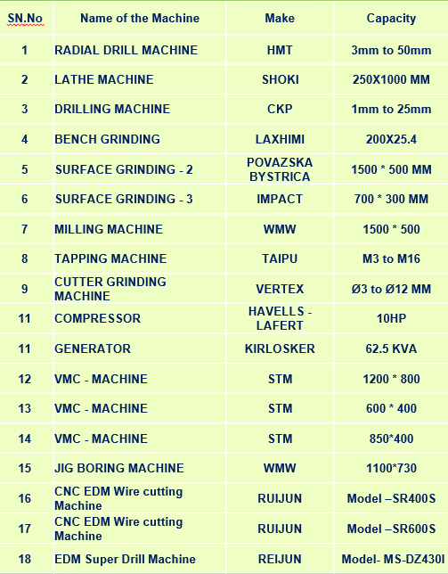
TOOL ROOM

Slide 8
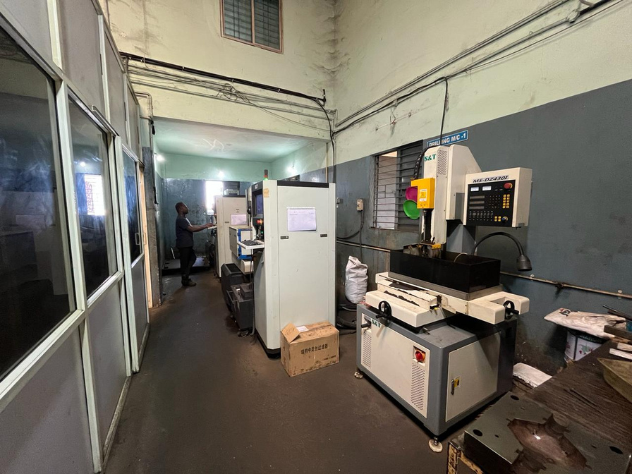
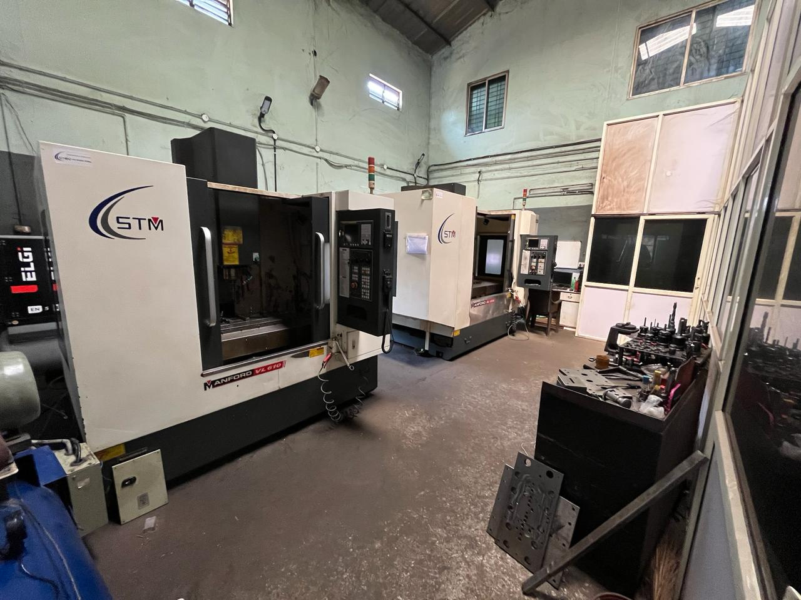
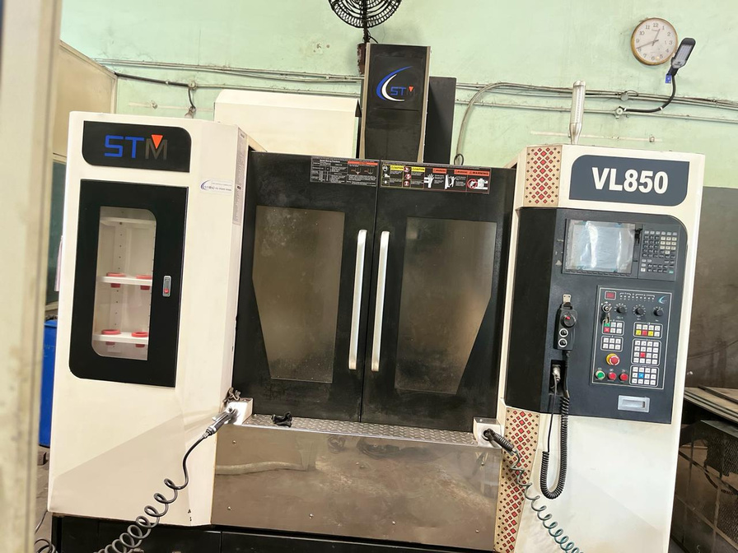

Slide 9
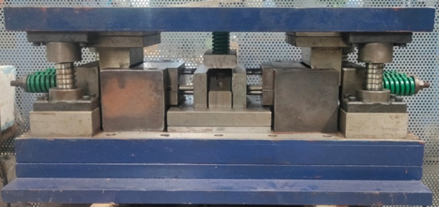
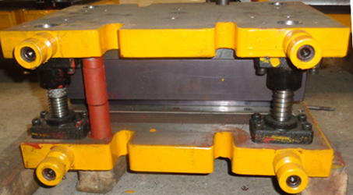
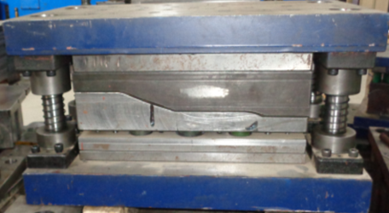
PRESS
TOOL
Cam– Piercing Tool
Forming Tool
Trimming Tool

Slide 10
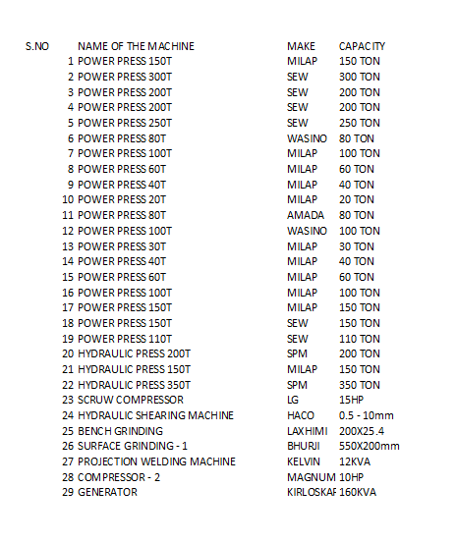

PRESS SHOP

Slide 11

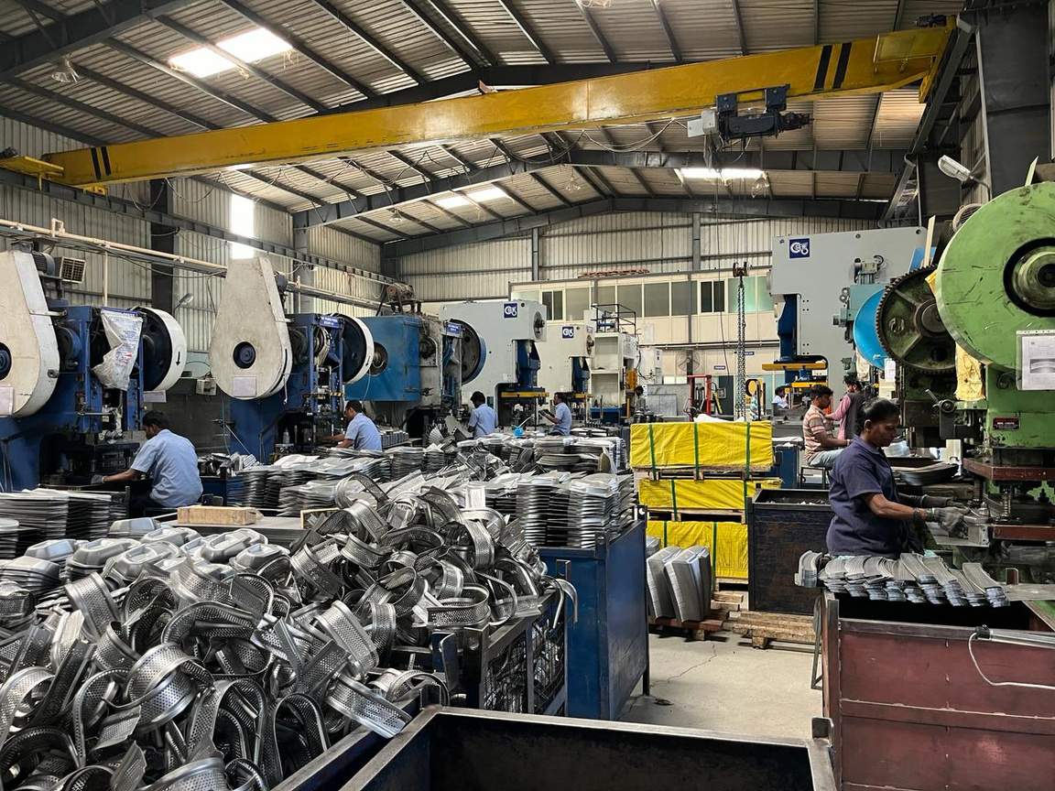
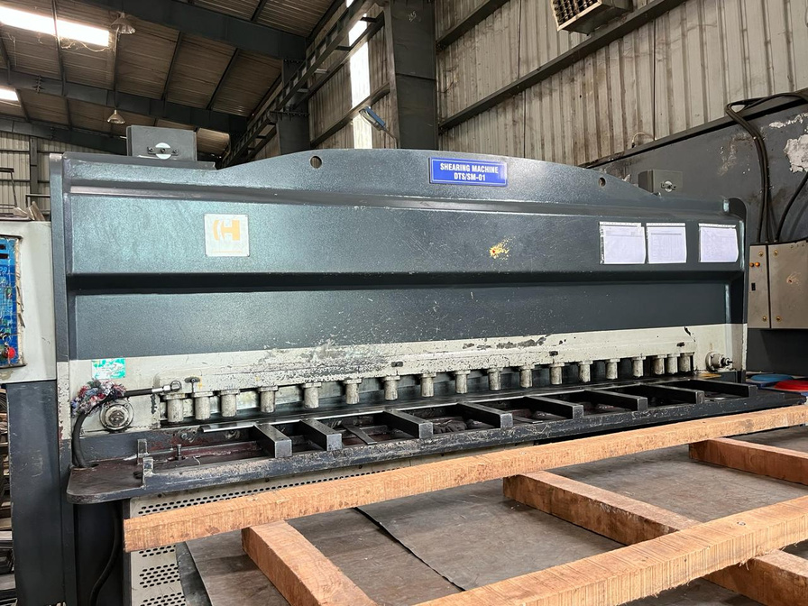

Slide 12
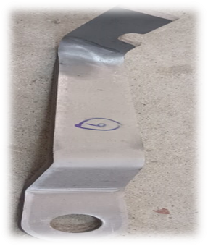
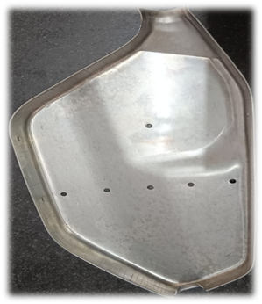
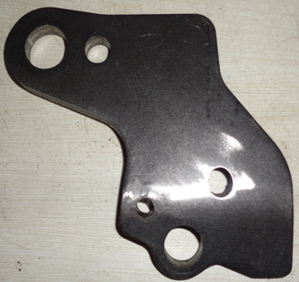
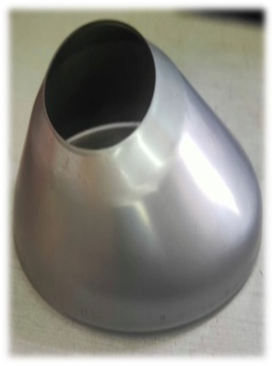
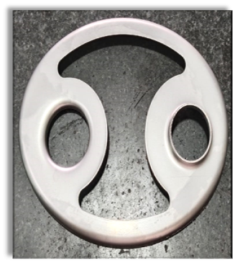
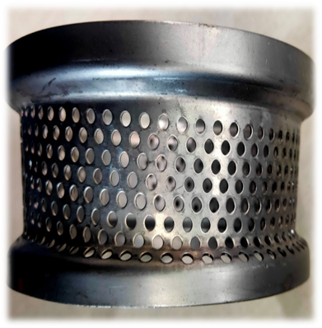
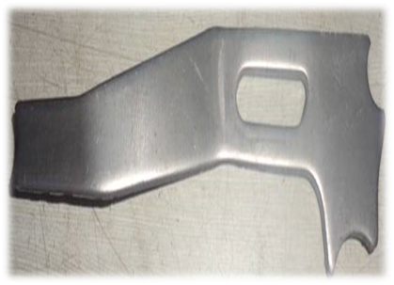
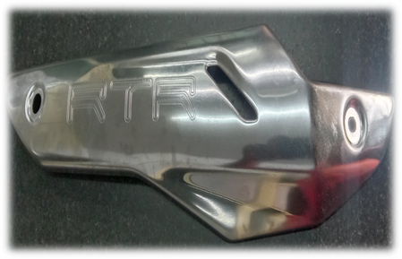
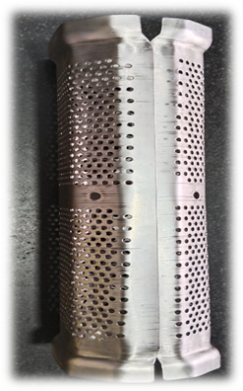
PRESS PRODUCTS

Slide 13
Gallery

Slide 14
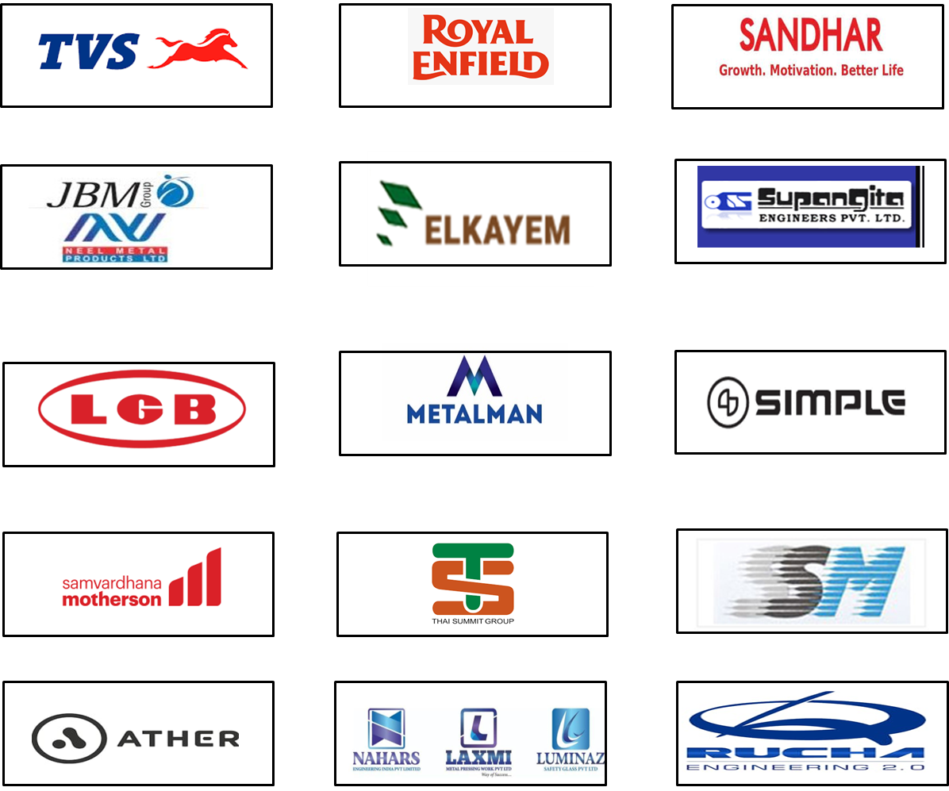

OUR
CUSTOMERS

Slide 15


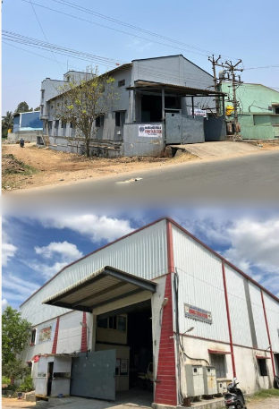



Contact Us
Call us:
9750939432/33
Email us:
dynamic_tooling@yahoo.co.in
Location:
S.No:14/2, Plot No.2-4, DTS Complex, Anumepalli, Near Rejeswari Layout, Zuzuvadi, Hosur

Slide 16
